Slide 1

Book Club Organizer
CPSC 5340 – Final Project
Elif Dede Yildirim
Auburn University
Notes:
For the final project, I created a virtual book club organizer app using Firestore database.

Slide 2
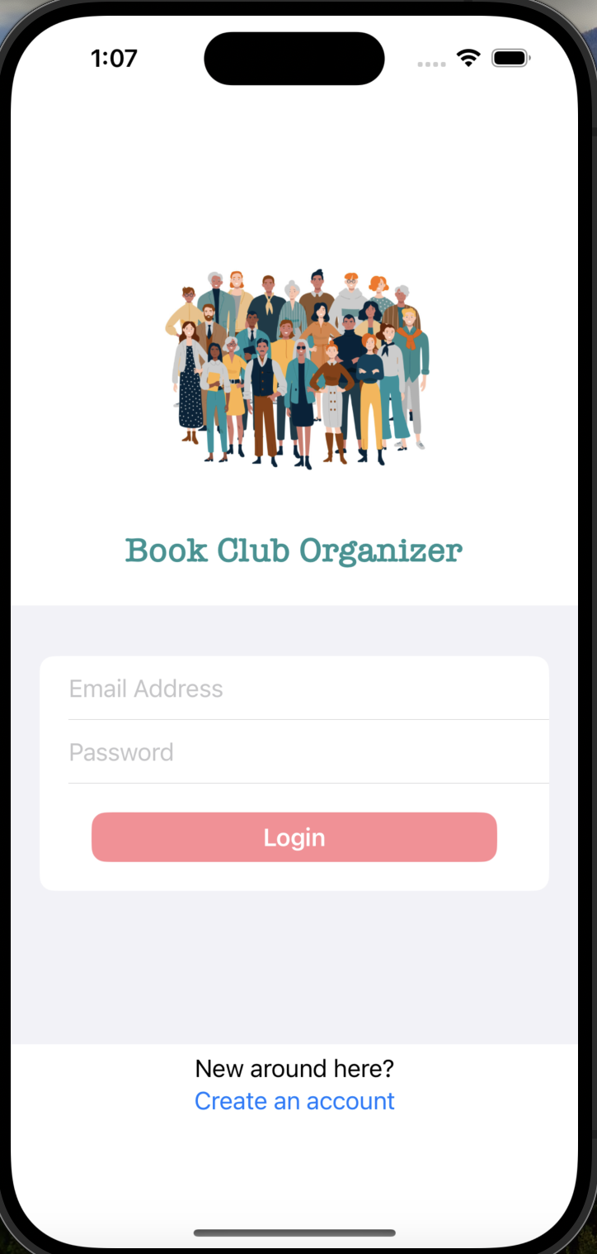

Login Interface

Slide 3
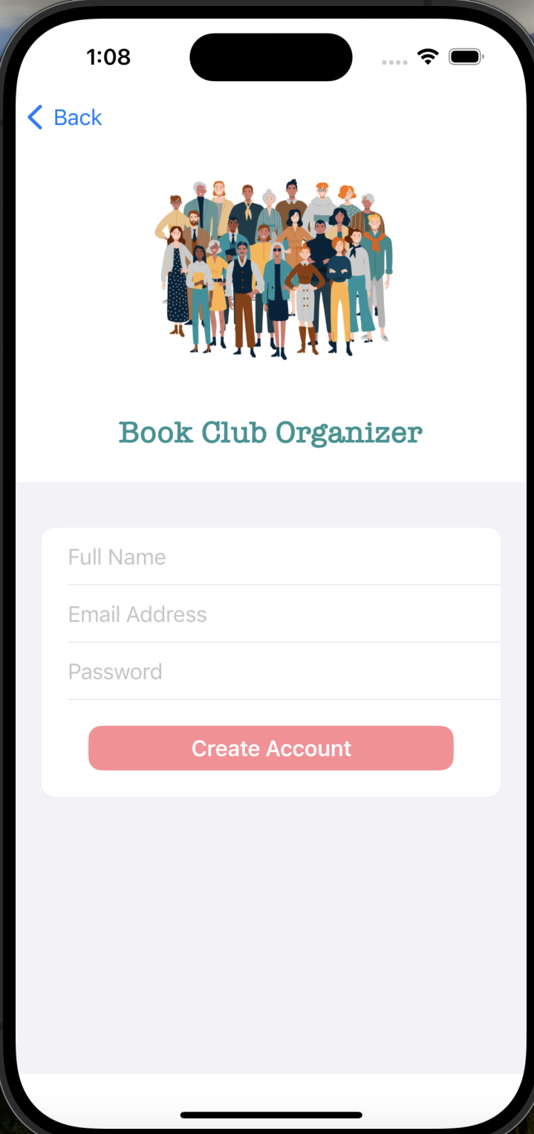
Create Account

Slide 4
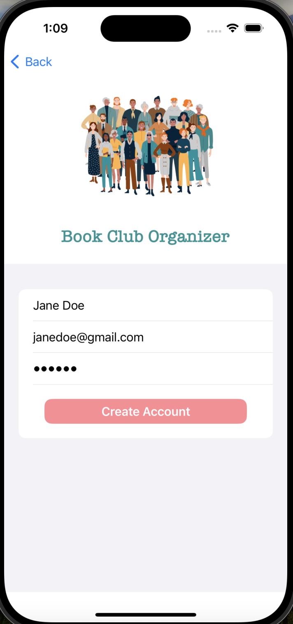
Create Account

Slide 5
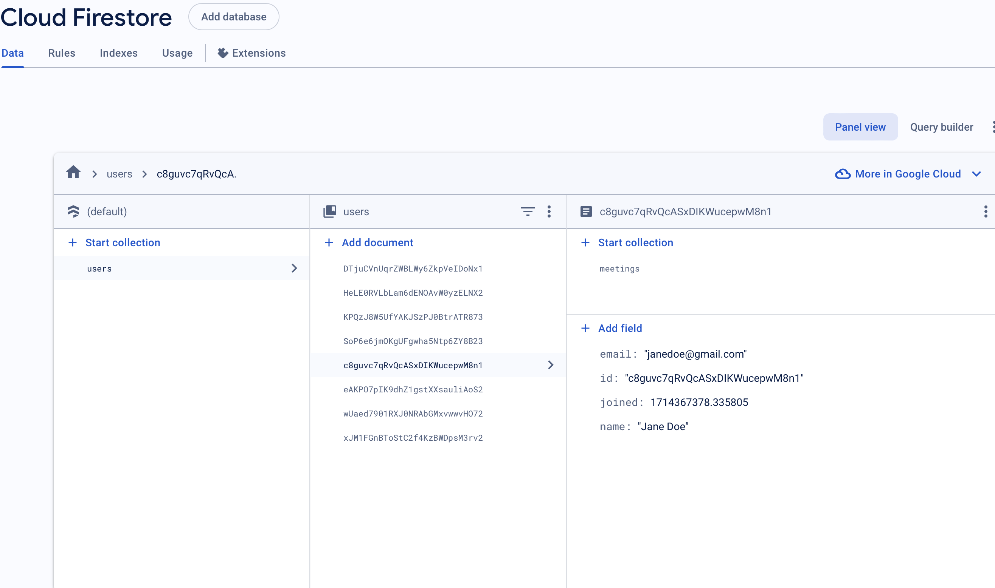
User Info
Notes:
firestore adds the user information to the user database.

Slide 6
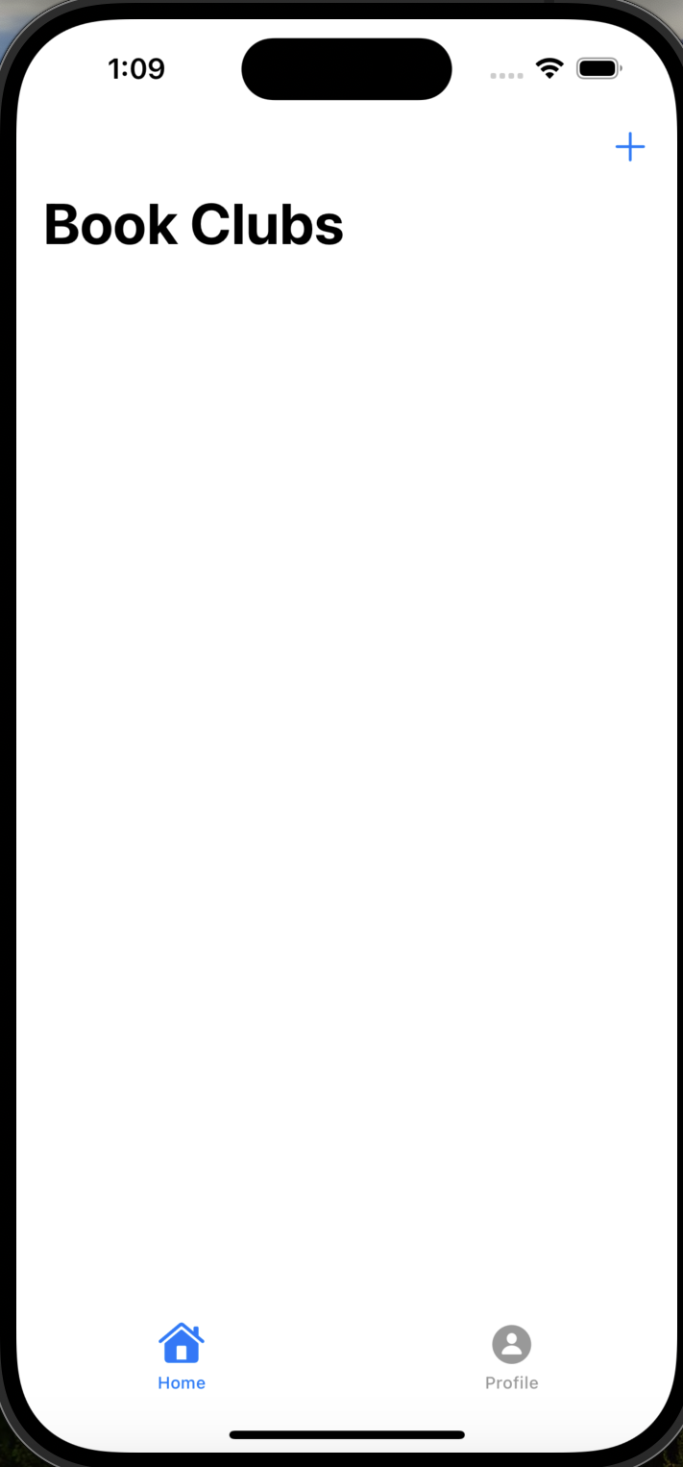
Home Screen

Slide 7
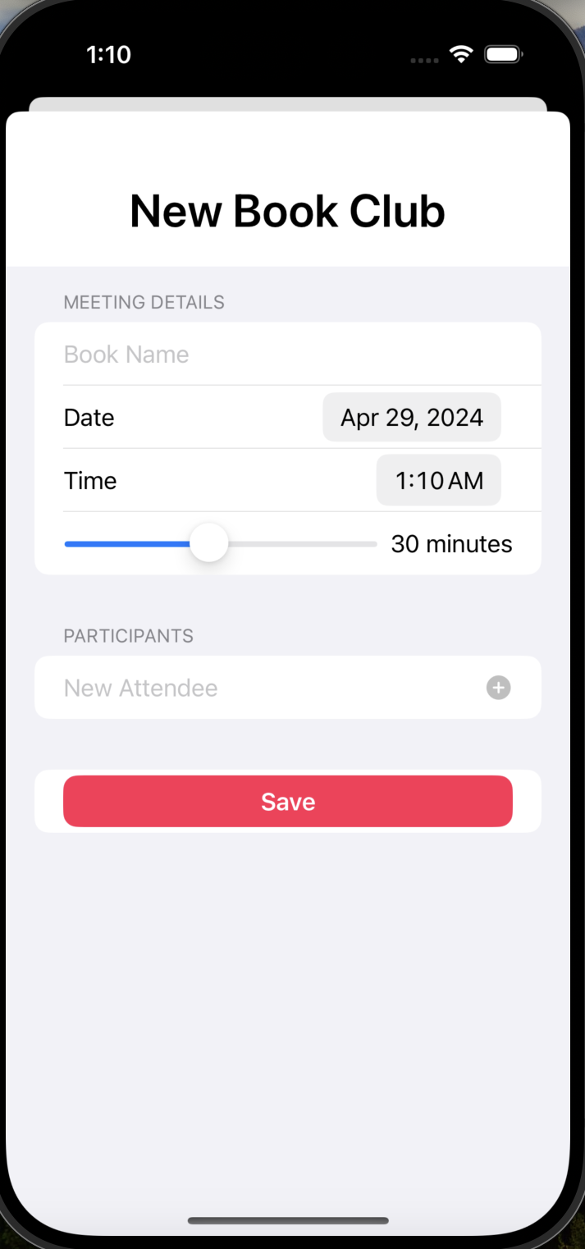
Book Club Entry

Slide 8
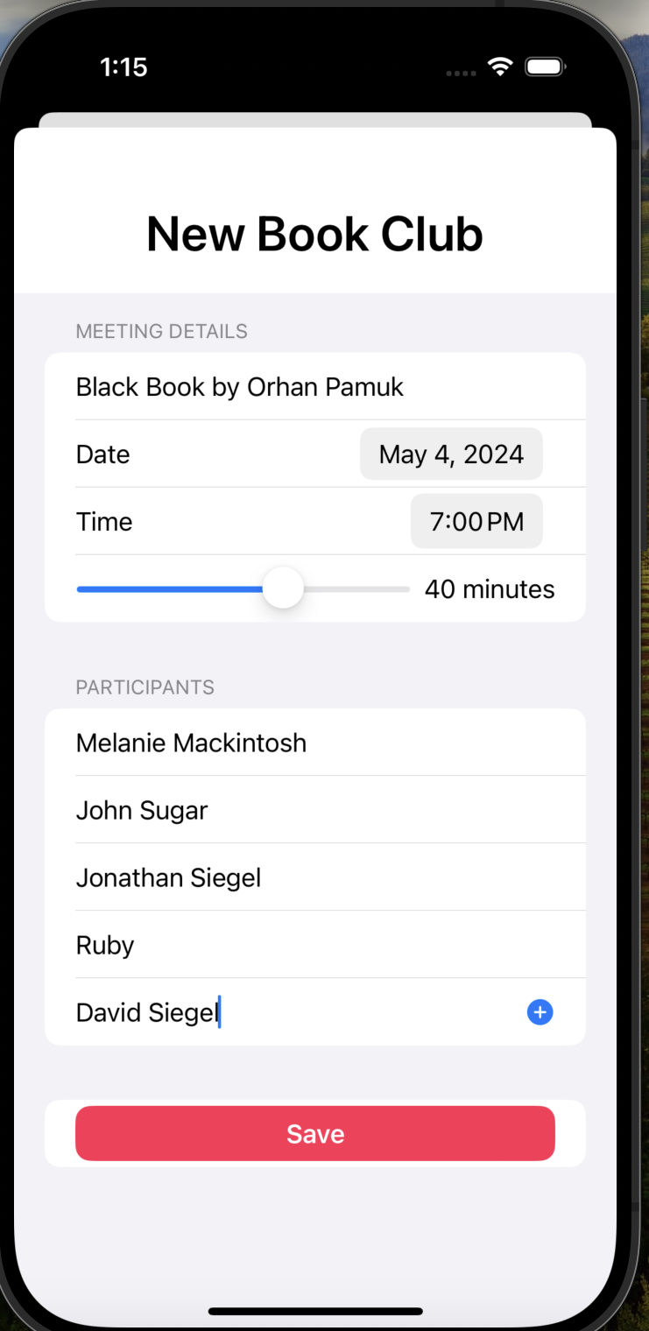
Book Club Entry

Slide 9
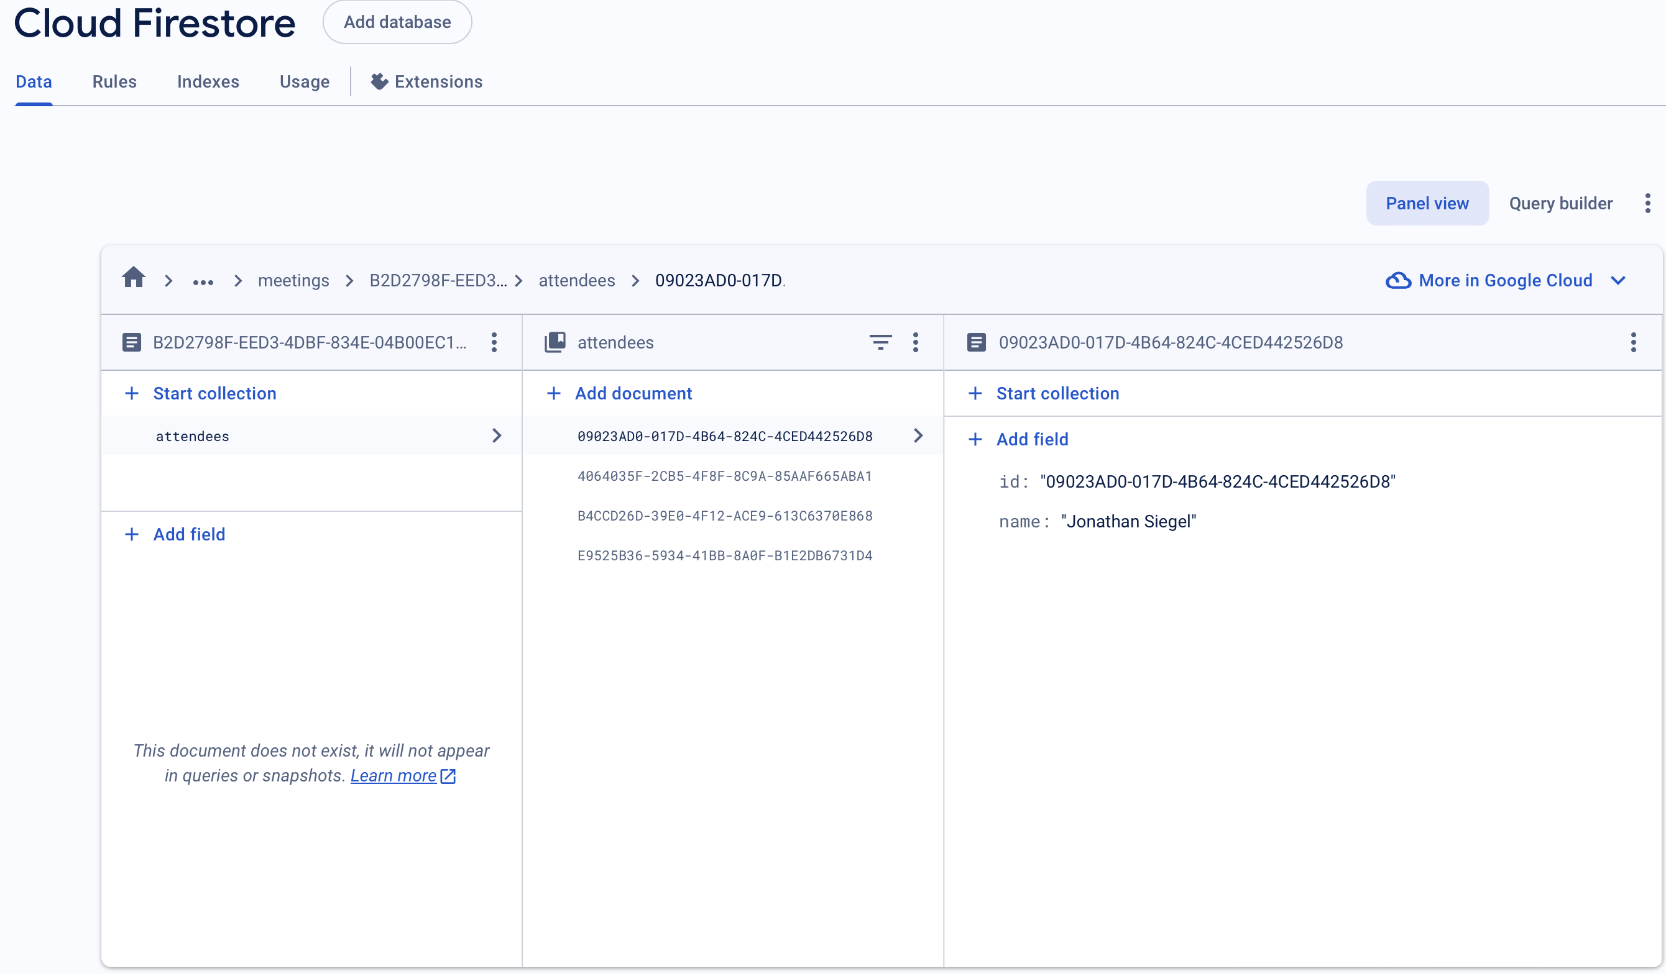
Saved Meeting Info
Notes:
Firestore also stores the meeting id, and attendees when user adds a book club meeting to their list.

Slide 10
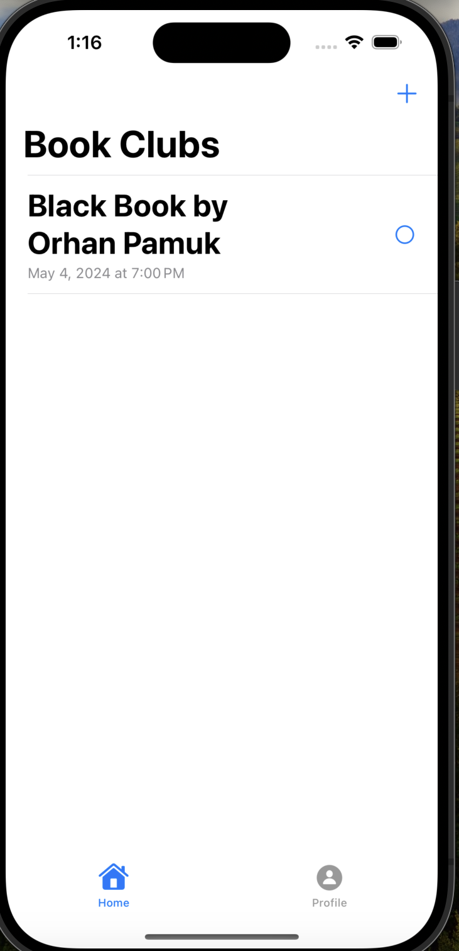
Book Club
Meetings List

Slide 11
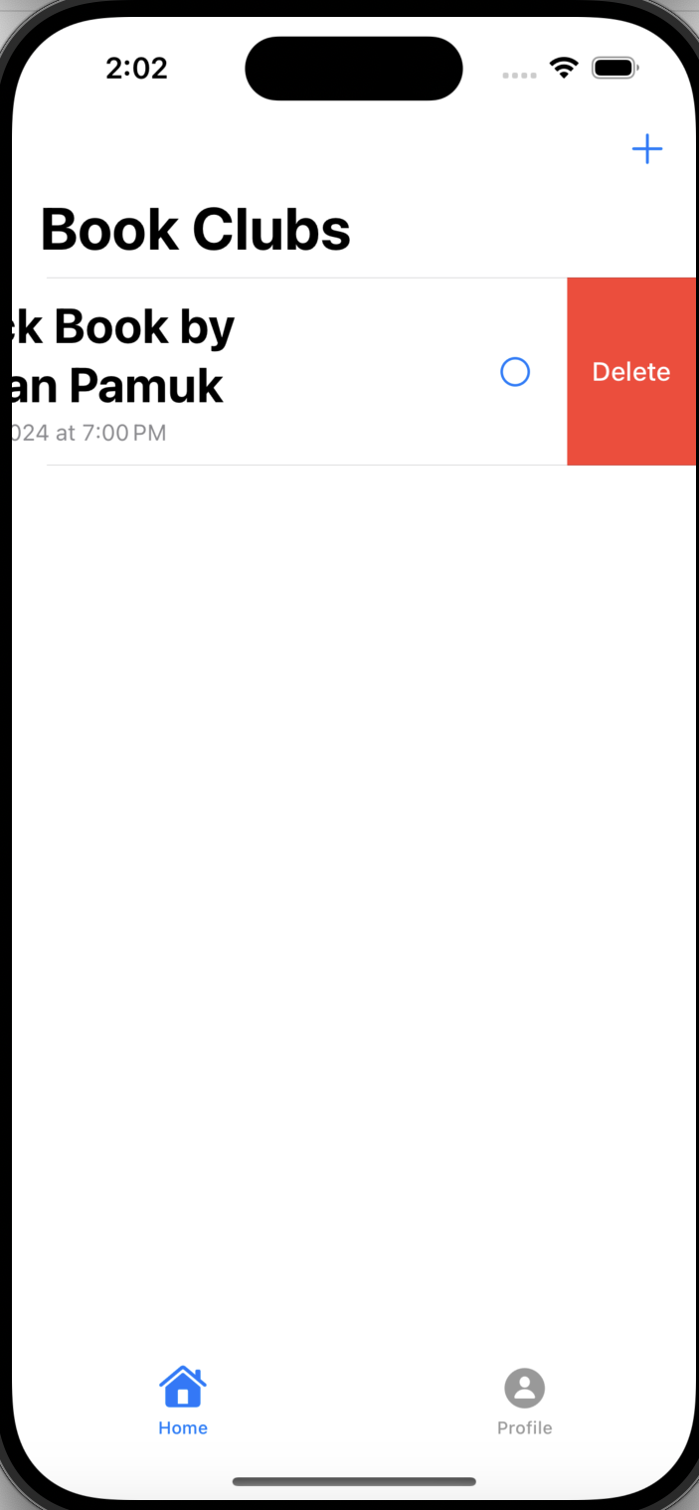
Add/ Delete

Slide 12
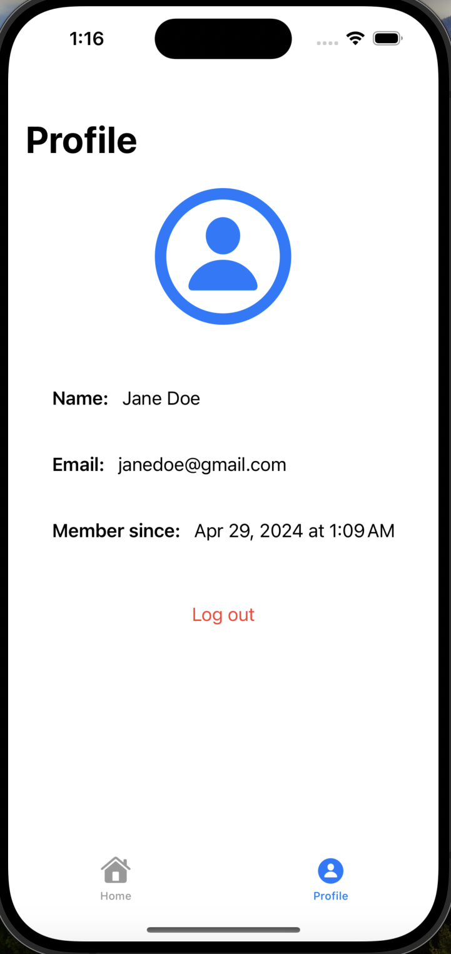
Profile Page

Slide 13
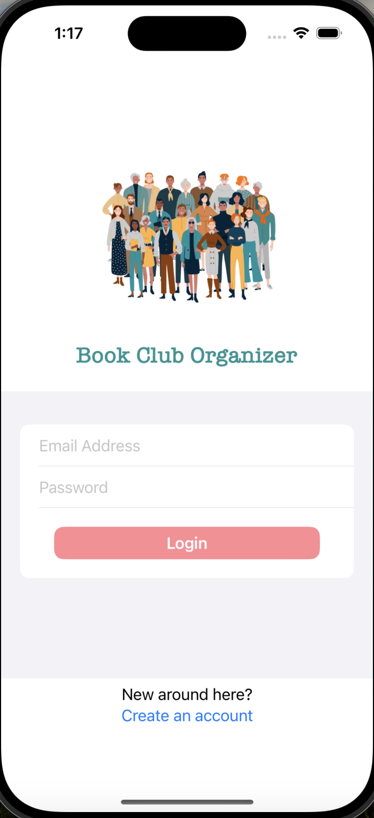
Log out
Log in

Slide 14
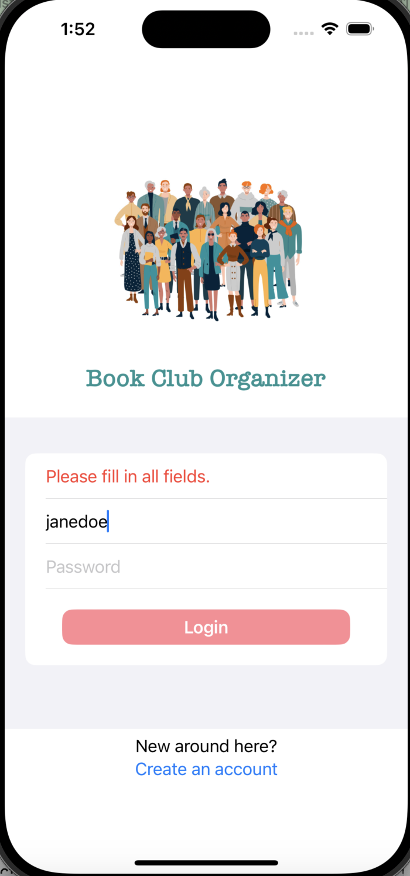
Error Handling

Slide 15
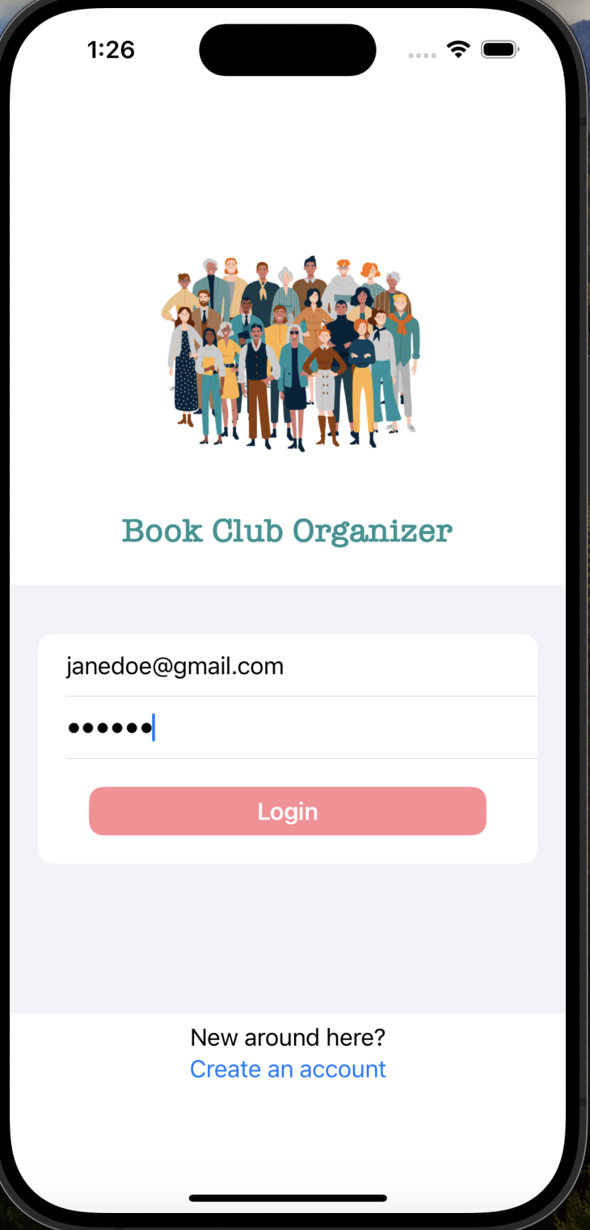
Login with Existing Account

Slide 16
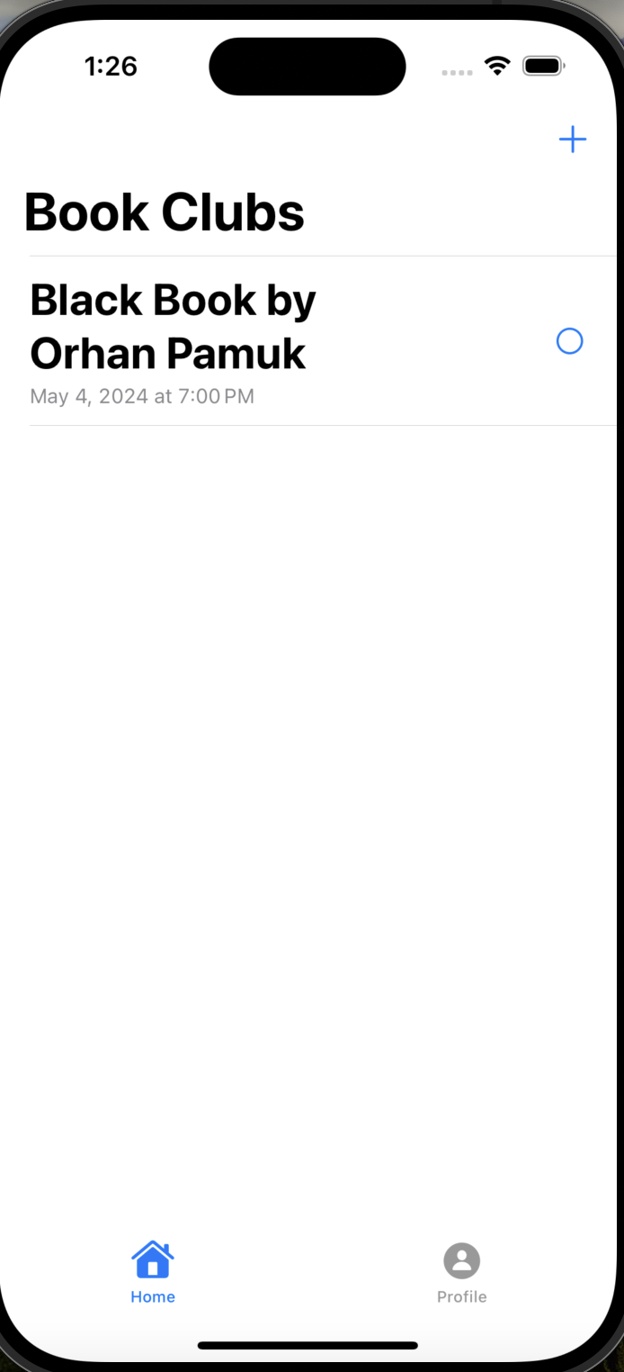
Saved Book Clubs

Slide 17

Improvements
Theme Customization
Accessibility
User Picture
Social Media Accounts

